Slide 1
Calculus
F 4 October 2013

Slide 5
1+1=
1
2

Slide 6
1+1=
1
2
3
4

Slide 7
1+1=
1
2
3
4

Slide 8
1+1=
1
2
3
4

Slide 9
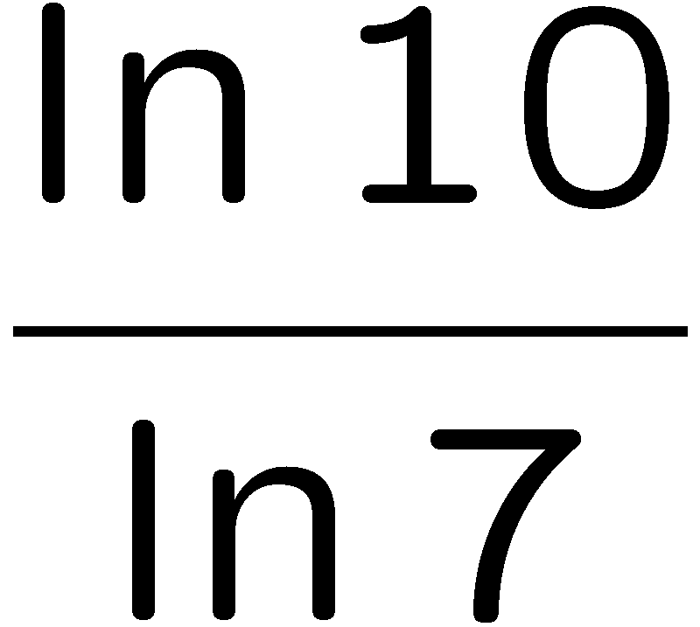
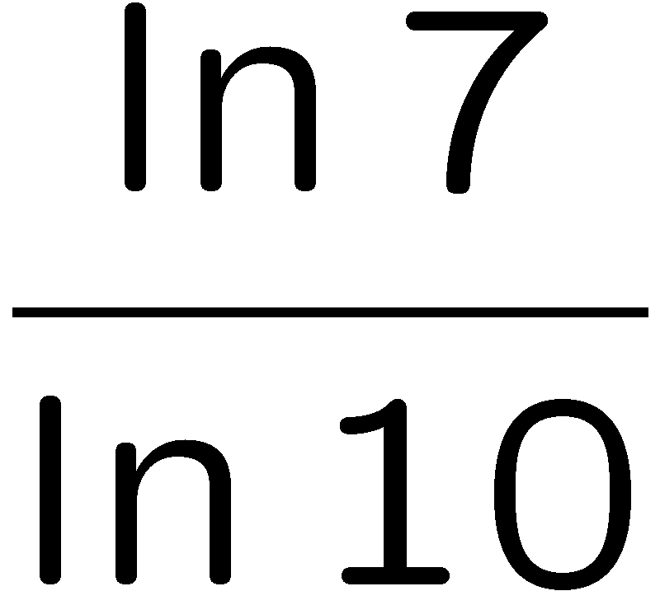
1+1=
1
2
3
4

