Slide 1
Calculus
F 11 October 2013

Slide 5
1+1=
1
2

Slide 6
1+1=
1
2
3
4

Slide 7
1+1=
1
2
3
4

Slide 8
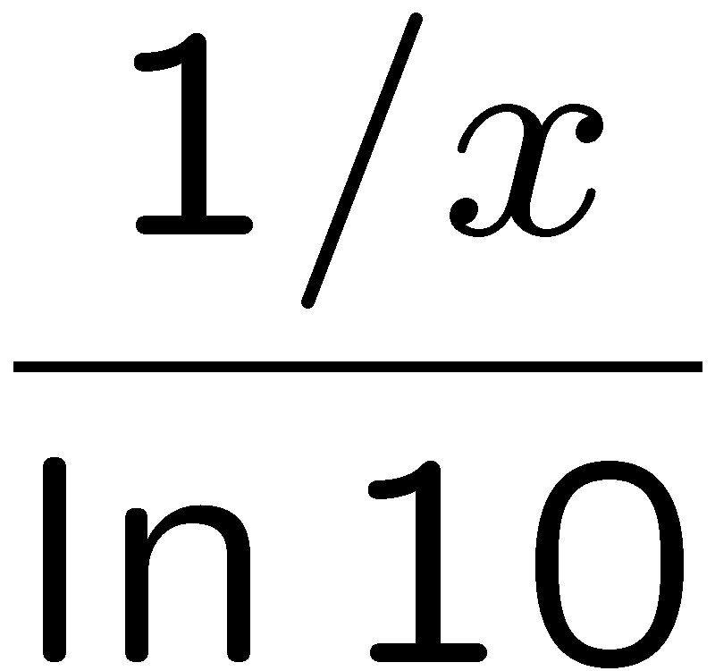
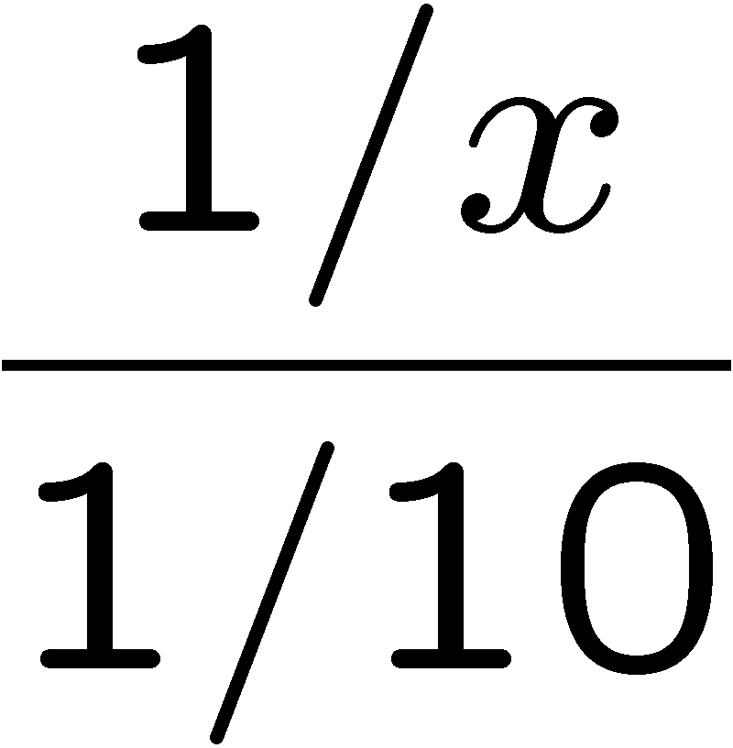
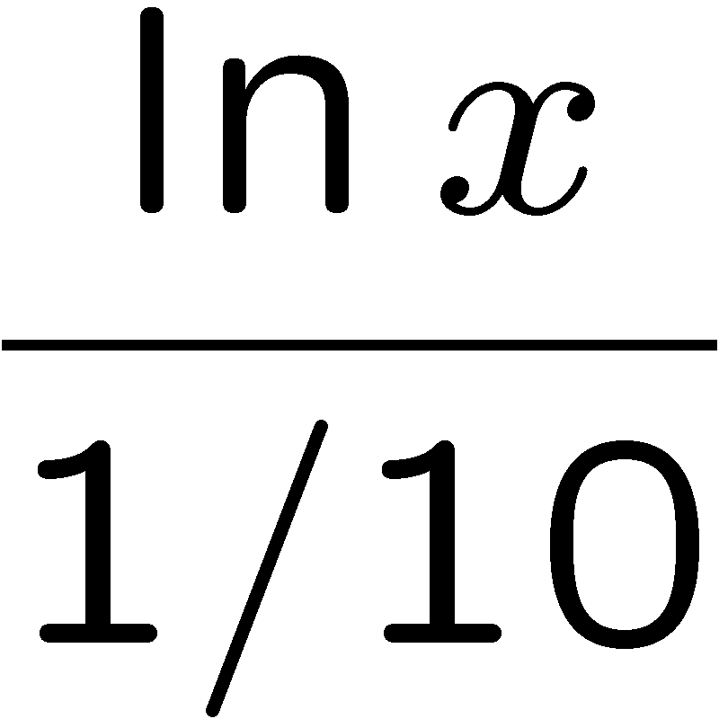
1+1=
1
2
3
4

Slide 9
1+1=
1
2
3
4

Slide 10
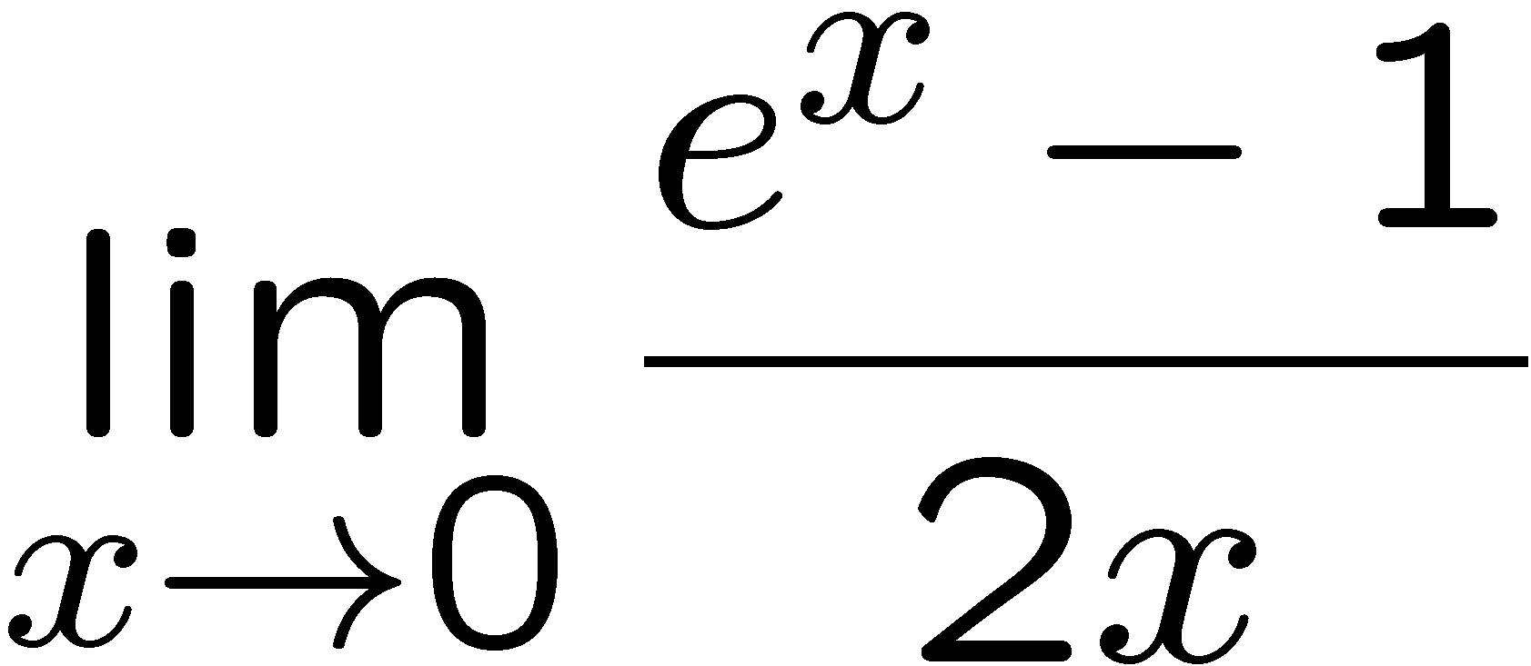
1+1=
3
4
1
2

