Slide 1
CALCULUS
Even more graphing problems

Slide 2
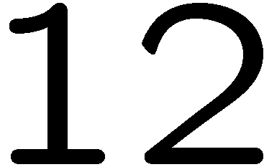

Slide 5
