Slide 1
CALCULUS
The Fundamental Theorems of Calculus,
problems

Slide 2
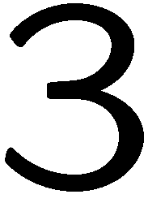
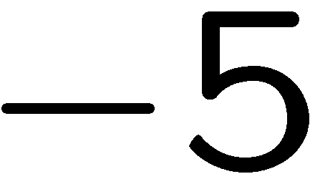

Slide 10
