Slide 1
CALCULUS
Optimization

Slide 2
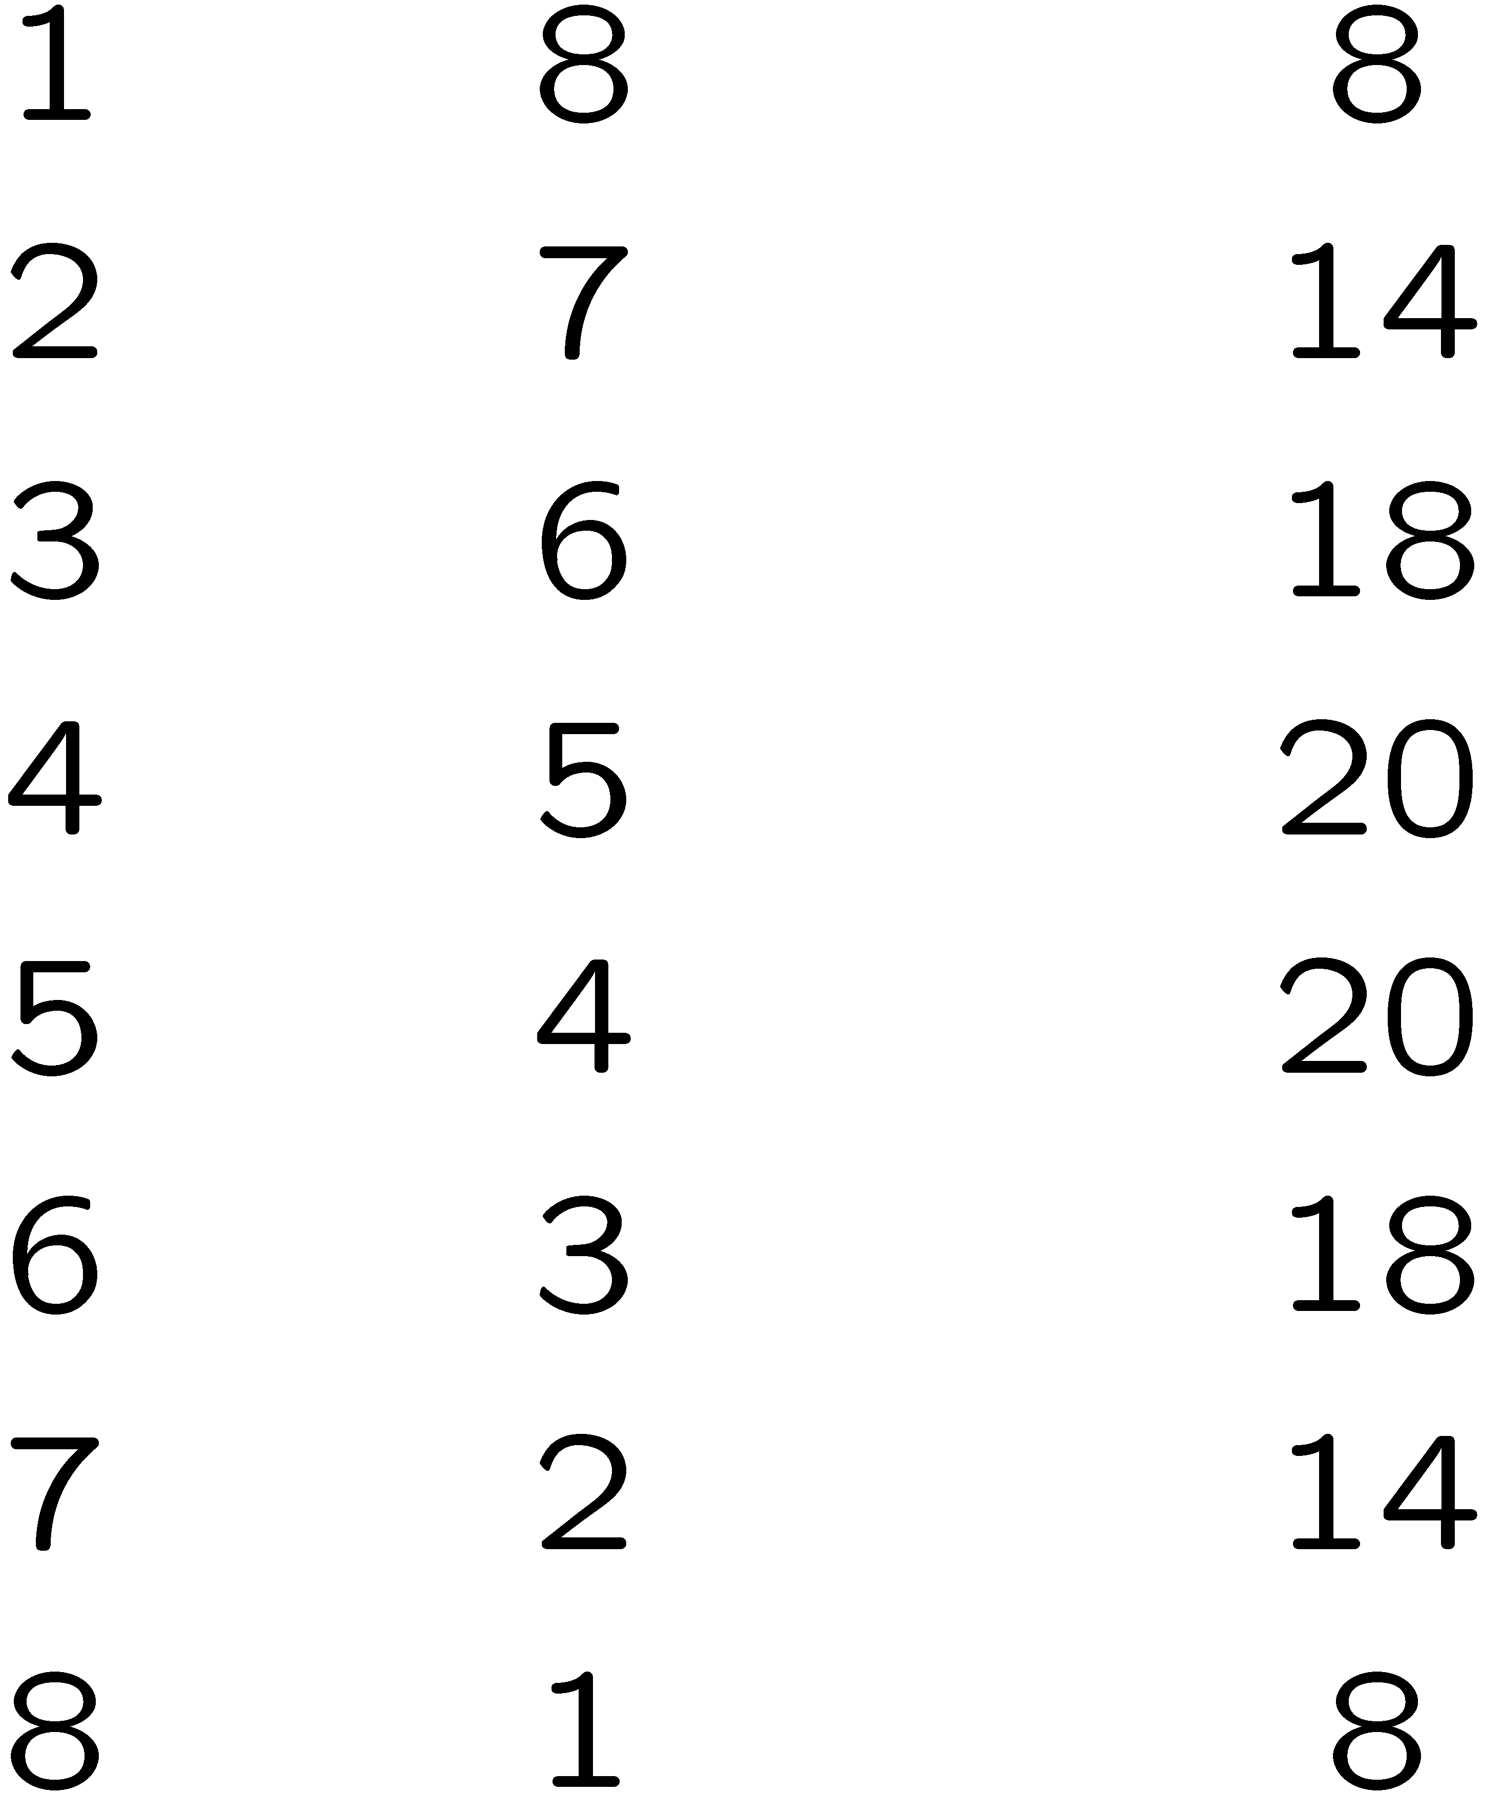

Slide 9
P
θ₀
5 mph
Q₀
3 mph
φ₀
R

