Slide 1
CALCULUS
Definite integration and Riemann sum problems

Slide 4
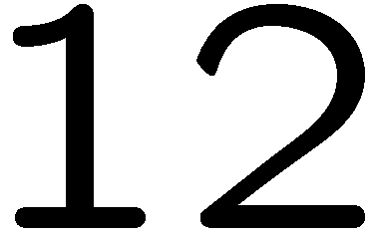
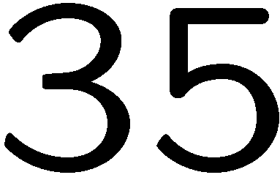
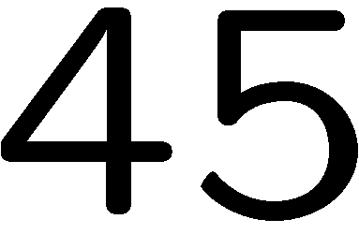
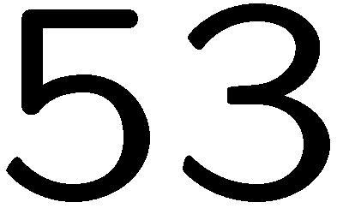
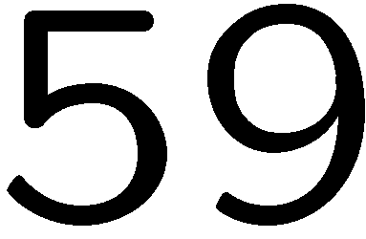
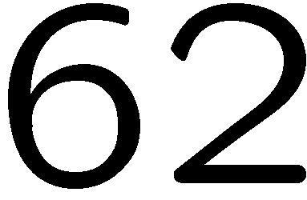
Notes:
gasf

Slide 5
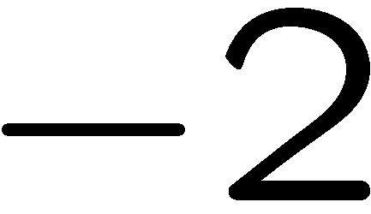
Notes:
gasf

Slide 6
Notes:
gasf

Slide 7
Notes:
gasf

Slide 8
Notes:
gasf

Slide 9
Notes:
gasf

Slide 10
Notes:
gasf

